Slide 1


Hallo !!!
Group 7
Christian Frans Mukuan
Deyaninta Ekabriela Permata
Mufadhal Faraz Addhifa
Notes:
*Mufadhal

Slide 2
Implementation of Information Technology in Teacher’s Room
Notes:
*Mufadhal
Today, we want to present our project named Implementation of Information Technology in Teacher’s Room.

Slide 3
Agenda
The problem and Solution
Hardware
01
03
Output Device, Input Device, PC, Network Device (including budget)
02
Network Design
04
Software
Teacher’s room network design
System Software, Application Software (including budget)
Notes:
*Christian
This is our agenda for today,
The first ever, we will talk about The Problem and solution in the Teacher’s room
The second, it is all about Network Design in the teacher’s room
The third, we will tell you what kind of Hardware that we use in this project
The fourth, of course if it is a hardware there will be the software too

Slide 4
The Problem
How the teacher transfers data from his/her computer to another computer?
How the teacher search information from his/her computer ?
Notes:
*Deya
So, this is the problem in our project.

Slide 5
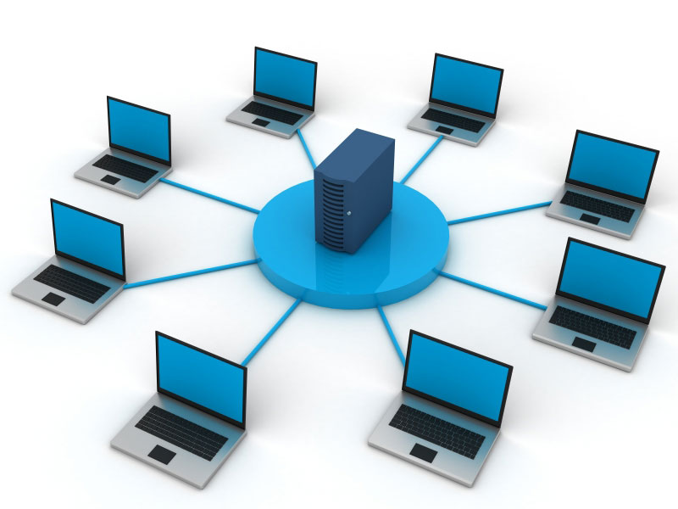

The Solution
Computer Network
Website
Notes:
*Deya
To answer all the problems in the previous slide, we use a computer network that we have designed. To transfer data from 1 PC to another PC, the teacher only has to open the network and then send the file that they want to give or share to another PC. All that can happen because it is connected to the same switch. Traffic to search for specific information on the internet, we have agreed that our network architecture is connected to internet service providers or ISPs that are connected using a modem/router that is connected to the switch as well. So the teacher can be easily access the internet to find the information needed.

Slide 6
Network Design
Notes:
*Christian
Second, Network Design in the teacher’s room

Slide 7
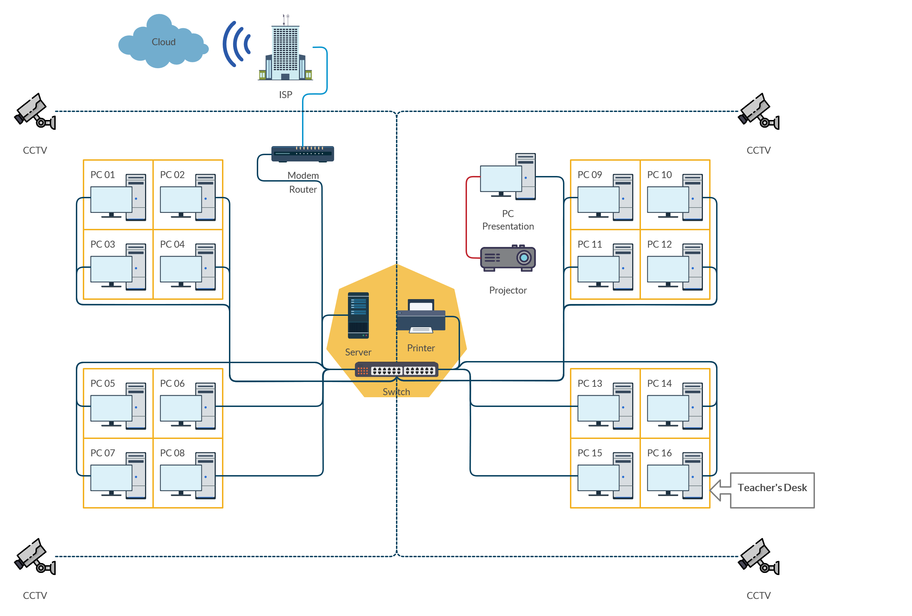
Star Topology Design
1 Server
1 Modem Router
1 Switch
1 Printer
1 Projector
17 PCs
4 CCTVs
Notes:
*Christian
As you can see, there are 1 Server, 1 Modem/Router, 1 Switch, 1 Printer, 1 Projector, 17 PCs divided to 4 booth, and 4 CCTVs that exist in the corner.
How this network design work?
First, we use 1 PC as a server, it grouped in the booth with printer and switch by the way. The Server is connected to Modem Router to run or reach the Internet Service Provider.
Then, the PC is connected too with the Switch that connected too with 16 Client-PC that divided in to 4 booth + 1 PC for Presentation. Another device that connected to the switch are Printer to printout many documents from PCs, and 4 CCTVs to be displayed in the Server PC.
The last but not least, the Projector is connected with PC Presentation to displayed any slides or any display from the pc such as the desktop, application, or even media player.

Slide 8
HARDWARE
Notes:
*Mufadhal
The hardware that we use on this project

Slide 9
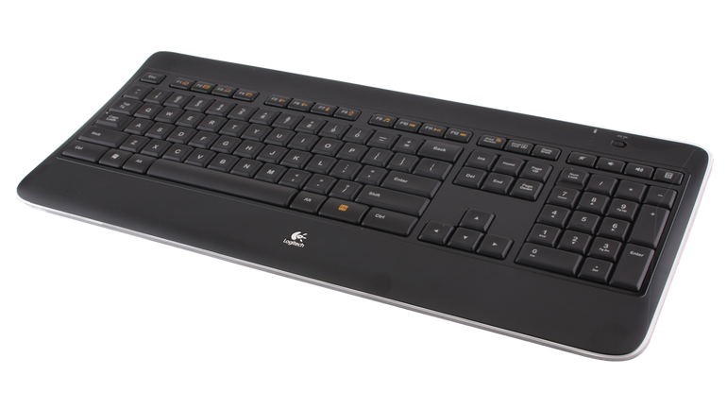
Keyboard
Logitech K800
Backlit Keyboard
Silent Keyboard
Wireless Keyboard
Charger Keyboard
Rp. 1,000,000 x 17 = Rp. 17,000,000
Notes:
*Mufadhal
We use Logitech Keyboard K800
Why do we used this keyboard ?
Because this keyboard is a wireless keyboard, backlit keyboard, silent keyboard, and this keyboard is a charger keyboard. So if the keyboard battery runs out, it can be recharged

Slide 10
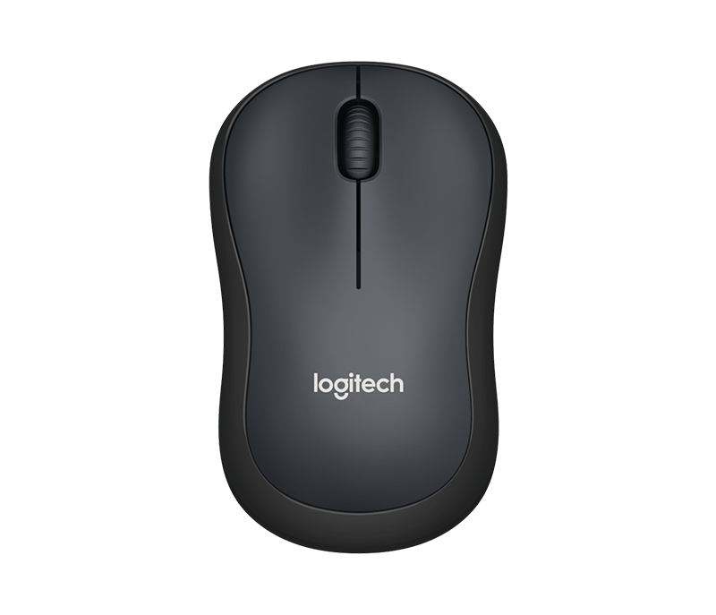
Mouse
Logitech M220
Wireless Mouse
Silent Mouse
9,9 cm x 6 cm x 3,9 cm
Logitech Unifying receiver with 1 AA batterie (pre-installed)
Rp. 100,000 x 17 = Rp. 1,700,000
Notes:
*Mufadhal
We use Logitech mouse M220.
Why do we used this mouse ?
It is a wireless mouse with silent feature and the size of the mouse is very comfortable.

Slide 11
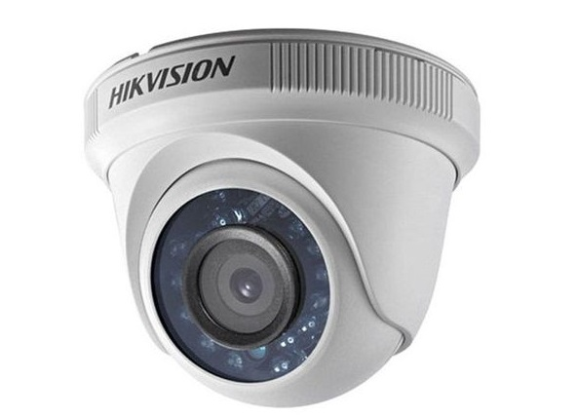
CCTV
Hikvision DS-2CE56DOT-IRP
Indoor CCTV
1920 x 1080 resolution
Video frame rate up to 1080p@30fps
Suitable in all weather
Rp. 270,000 x 4 = Rp. 1,080,000
Notes:
*Mufadhal
We use Hikvision CCTV DS-2CE56DOT-IRP
It is a indoor cctv with 1920 x 1080 resolution and video frame rate up to 1080p@30fps, and this cctv suitable in all weather.

Slide 12
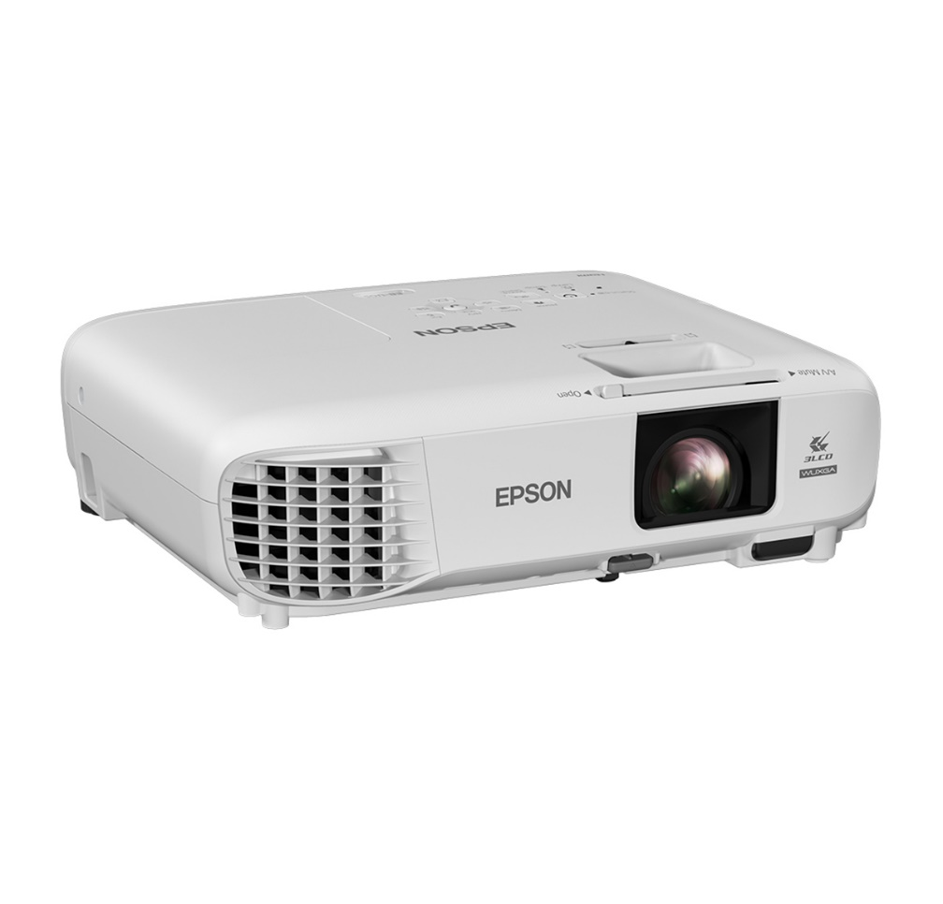
PROJECTOR
Epson EBW05
10,000 hours lamp life in eco-mode
With stunning colour and white brightness of up to 3,300 lumens
Rp. 6,400,000 x 1 = Rp. 6,400,000
Notes:
*Mufadhal
We use Epson EBW05 projectors, the lamp of a projector can life up to 10,000 hours in eco-mode. This projector is equipped with stunning colors

Slide 13
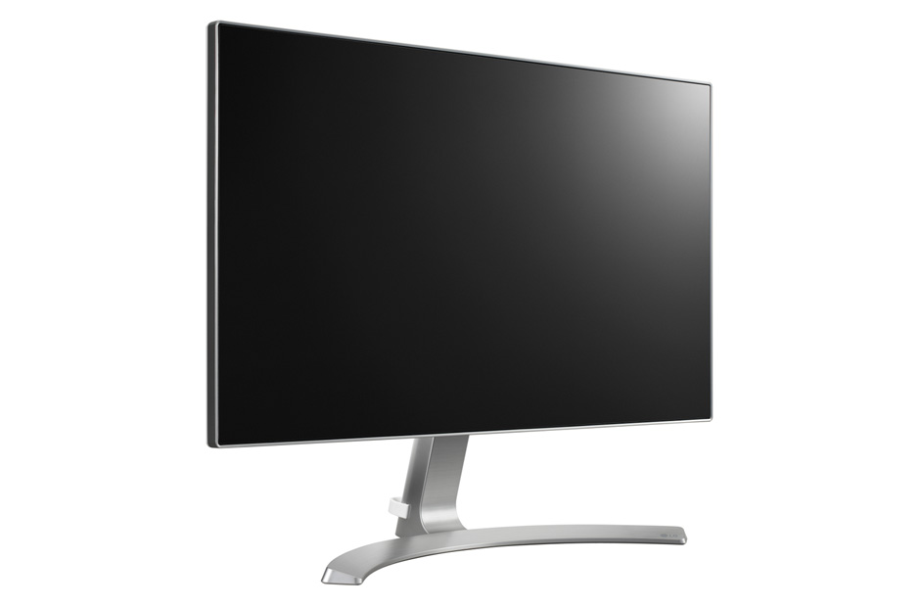
DESKTOP MONITOR
LG 24MP88HM-S
Full HD (1080p)
24"
Brightness 250 nit
Display Colors 16.7M
Rp. 2,500,000 x 17 = Rp. 42,500,000
Notes:
*Christian
For the desktop monitor, we used LG 24MP88HM-S.
Why we used this as our desktop monitor?
Because it makes the work desk looks elegant, the IPS panel that gives a real color impression and a very wide view angle makes this monitor highly recommended for the teacher.

Slide 14
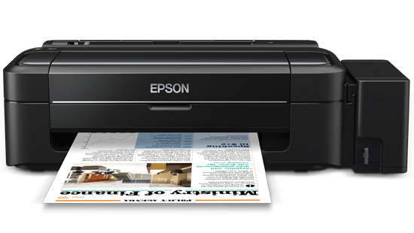
PRINTER
Epson L120
High-yield ink bottles
Print speed up to 8.5ipm for black-and-white and 4.5ipm for color
Rp. 1,600,000 x 1 = Rp. 1,600,000
Notes:
*Christian
And, for the printer we used Epson L120.
Why do we use Epson L120?
Because this printer is a mid-end printer that can accommodate all types of black and white documents with minimal graphics

Slide 15
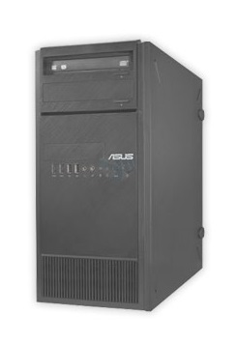
SERVER
ASUS TS110-E8-PI4 310107
E3-1220v3 3.1GHz Turbo 3.5 GHz 8MB L3 Cache
3.1 GHz Turbo 3.5 GHz 8MB
2x4 GB DDR3 ECC
1TB SATA 7.2Krpm Xtra Endurance HDD
2 Intel I210AT Gigabit LAN
x16 GPU Card Supported
1 PSU 300 Watt 80+
Rp. 12,400,000 x 1 = Rp. 12,400,000
Notes:
*Christian
For the PC server, we use ASUS TS110-E8-PI4 310107
You can see and you can know what are the specification contains from this PC in the display.
Why do we used this PC as our Server?
TS110-E8-PI4 is an entry-level tower server that delivers business-class performance, energy efficiency and reliability. It supports the latest Intel® Xeon® processor E3-1200 v3 product family and offers high expandability, onboard RAID and complete remote server management via ASUS System Web-based Management (ASWM) Enterprise.

Slide 16
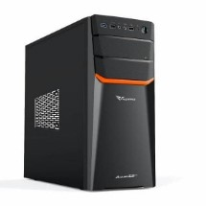
CPU
Assembly PC
Motherboard H55
Processor Intel Core i5 650
HDD Seagate 500GB
Memory DDR3 8GB
Rp. 2,200,000 x 17 = Rp. 37,400,000
Notes:
*Christian
For the Client PCs, we use this Assembly PC that contains this specification.
Why do we used Assembly PC for the teacher’s PCs?
Because we can choose what parts that we needed the most, the price is pretty low too, and the last but not least the hardware is easy to be upgraded too.

Slide 17
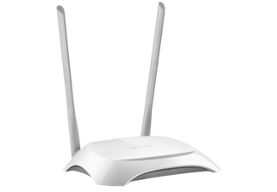
MODEM ROUTER
TP – LINK WR840N
300Mbps wireless transmission rate
Supports Access Point mode to create a new Wi-Fi access point
4 10/100Mbps LAN PORTS
Rp. 280,000 x 1 = Rp. 280,000
Notes:
*Deya
TP-Link’s TL-WR840N is a high-speed solution that is compatible with IEEE 802.11b/g/n. Based on that technology, TL-WR840N gives users wireless performance at up to 300Mbps, which can meet your most demanding networking needs, such as HD streaming and large files downloading.

Slide 18
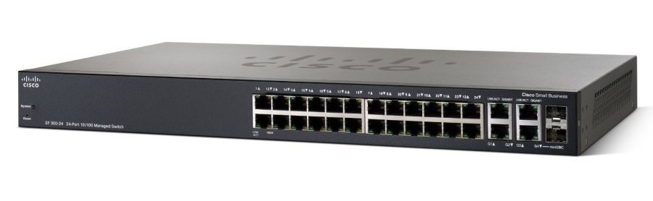
SWITCH
Cisco SF300
Can switch 9.52 mpps (millions of packets per second, 64 bytes packet size).
24 Ports
16 MB flash memory
Rp. 6,400,000 x 1 = Rp. 6,400,000
Notes:
*Deya
we use this device because this cisco SF300 can protect all your information and optimize your network bandwidth to deliver information and applications more effectively.

Slide 19
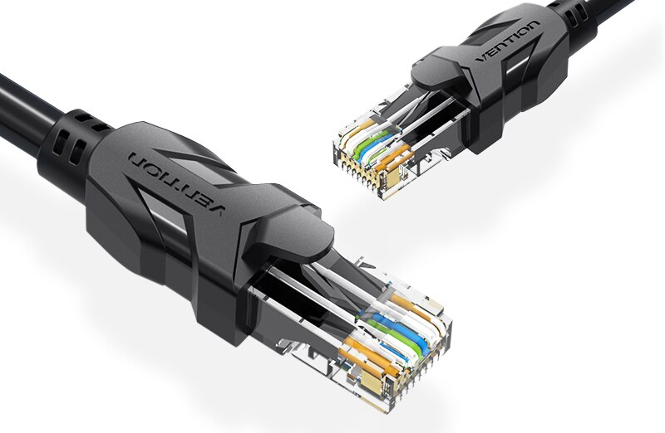
UTP Cable
Vention RJ45 Cat6
Flat Gigabit UTP
High speed data transmission rate (1 Gbps)
Wire Structure : Straight, Twisted Pair
Rp. 140,000/ 15M x 4 = Rp. 560,000
Notes:
*Deya
Why do we used this UTP Cable?
because the cable types above have good quality at the density of turns in each cable, as well as protectors of each thick cable so that they can transfer data properly and support connections of up to 1000Mbps or Gigabit network connections.

Slide 20
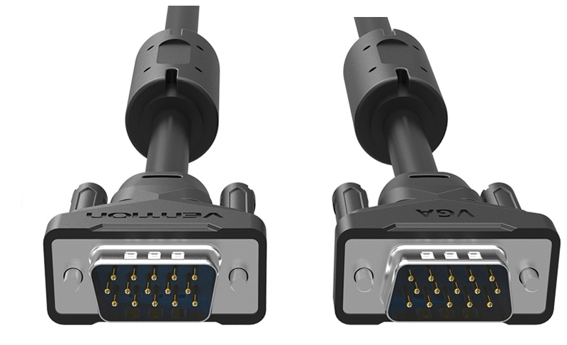
VGA Cable
VAG-B04 15M
15 M length
Oxygen Free Copper
Double magnets rings + alumunium foil
Diameter 7.5 mm
High Resolution
Rp. 190,000 x 1 = Rp. 190,000
Notes:
*Deya
Why do we used this cable?
Because VGA cable is used to connect the computer to the projector. This transfers the image signal from the computer to the monitor so that it can be displayed. And these VGA cables are often used by teachers when meeting in the teacher's room.

Slide 21
SOFTWARE
Notes:
*Christian
And now, we will talk about the software that we use on this project

Slide 22
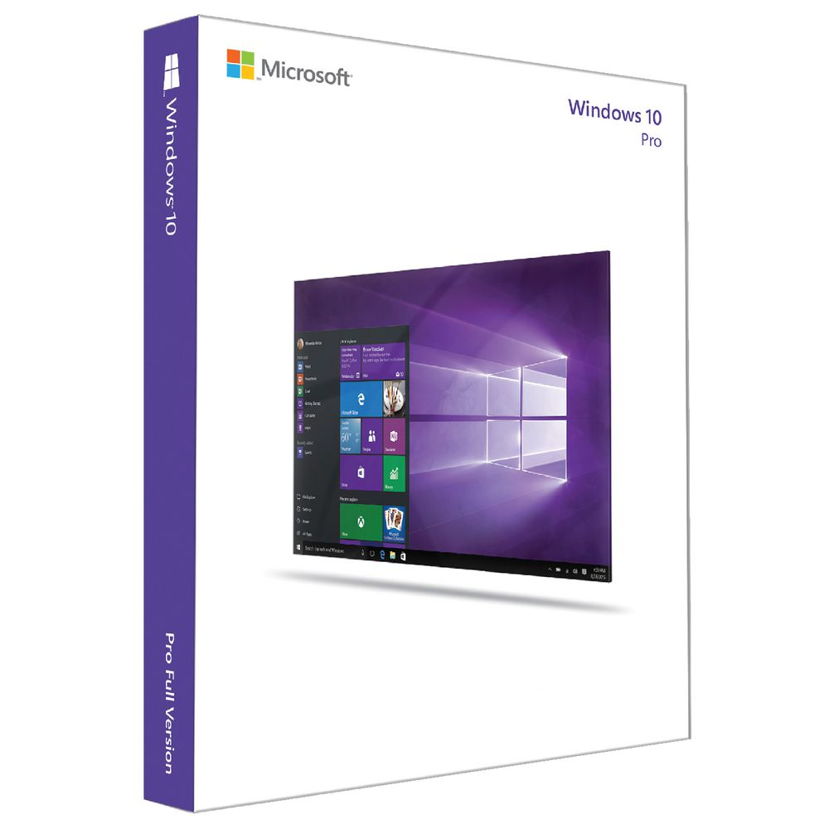
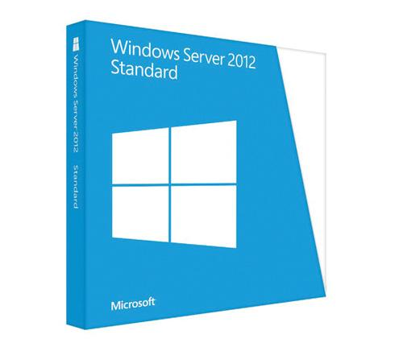
System Software Operating System
Notes:
*Christian
First, we use Windows 10 as our Operating System in Client – PC
Why do we used Windows 10? Because, it offers faster performance than ever windows edition or version that have been created and published. The multitasking is more fun to do too, and have been integrated with many devices such as mobile phone, tablet, and many others.
The second, we use Windows Server 2012 Standard as our Server Operating System
Why do we used Windows Server 2012?
Because Windows Server 2012 offers ease of use such as installation, deploy, maintenance, until troubleshooting.
Almost all hardware and software supported this kind of server.

Slide 23





Application Software
Word Processing Software | Microsoft Word Sticky Notes
Spreadsheet Software | Microsoft Excel
Presentation Software | Microsoft Power Point
Content Access Software | Google Chrome
Notes:
*Deya
So, we use application software in this project. First, we use Microsoft Office because it is used for many purposes including creating documents and notes, presentation, letters, memos, organize data, student reports and to compile school newsletters or newspapers. Second, we use Google Chrome to make it easier for teachers to teach, such as Google classrooms to interact with students while minimizing the use of paper when assembling assignments, and many more functions. Teachers can also fill out students grades through an electronic report card, and go to the Department of Education and Culture website to find out the latest information about education

Slide 24
Software Budget
Windows 10 Pro | Rp. 1,250,000 x 17 = Rp. 21,250,000
Windows Server 2012 | Rp. 3,500,000 x 1 = Rp. 3,500,000
Microsoft Office 2016 Professional Plus | Rp. 1,500,000 x 17 = Rp. 25,500,000
Notes:
*Mufadhal

Slide 25
Total Budget
Hardware = Rp. 127,510,000‬
Software = Rp. 50,250,000
Total = ‬Rp. 177,760,000‬
Notes:
*Mufadhal

Slide 26
Thank You !

